Slide 1
In-class Exercise 13 - Hough 2
Dhiren Gupta
-800902466

Slide 2
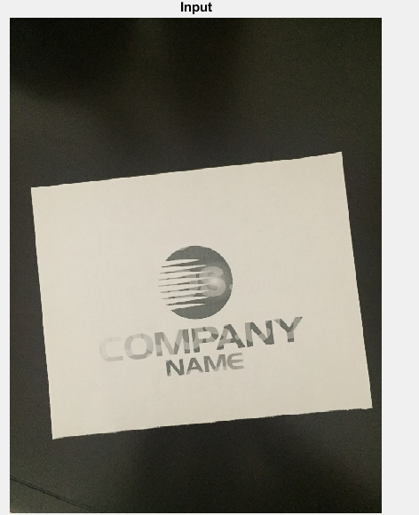
Input image

Slide 3

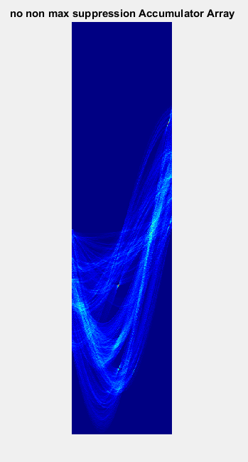
No Non Max Suppression
image
Accumulator

Slide 4


Output-No Non Max Suppression

Slide 5
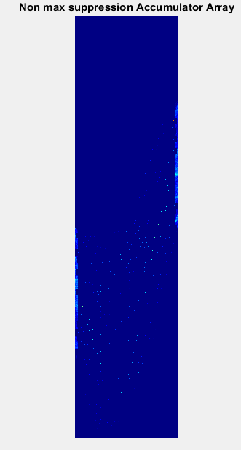
Non Max Suppression
Edge
Accumulator

Slide 6

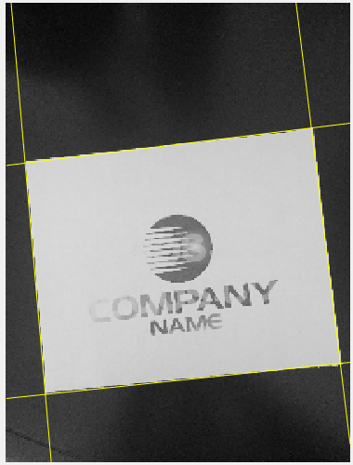
Output-Non Max Suppression

Slide 7
Thank You

